Slide 1
Enhancing farmer productivity through innovative technology solutions
CSE7302 - Capstone Project
Review-3
Batch Number: CSE_127
Under the Supervision of,
Ms. Bhuvaneshwari Patil
(Computer Science and Engineering)
Presidency University
Roll Number | Student Name
20221CSE0411 | C. Chand Basha
20221CSE0400 | V. Dinesh Reddy
20221CSE0408 | P. Abhisekhar Reddy
Name of the Program: CSE 7101 Capstone Project (Semester VIII)
Name of the HOD: Dr. Asif Mohammed
Name of the Program Project Coordinator: Dr. Jayavadivel Ravi
Name of the School Project Coordinators: Dr. Sampath A K , Dr. Geetha A

Slide 2
CONTENT
ABSTRACT
PROBLEM STATEMENT
LITERATURE SURVEY
OBJECTIVES
METHODOLOGY
EXISTING METHODS AND DRAWBACKS
PROPOSED METHODS AND FEASIBILITY STUDY
ARCHITECTURE DIAGRAM
MODULES
HARDWARE AND SOFTWARE DETAILS
TIMELINE
REFERENCE

Slide 3
ABSTRACT
Agriculture is a key sector that directly impacts food security and economic development. However, farmers often face challenges such as climate uncertainty, inefficient farming practices, and limited access to timely information. This project, “Enhancing Farmer Productivity through Innovative Technology Solutions,” aims to address these challenges using modern digital technologies. The system integrates data from weather forecasts, soil conditions, and crop requirements to support smart decision-making. It provides crop recommendations, optimized irrigation planning, and early alerts for potential risks. By using data analytics and automation, the solution helps reduce resource wastage and operational costs. The proposed approach improves crop yield, enhances farm efficiency, and supports sustainable agriculture. Overall, this project empowers farmers with technology-driven insights for better productivity and long-term growth.

Slide 4
PROBLEM STATEMENT
Farmers face challenges in making timely and accurate decisions related to crop selection, irrigation, and pest management due to lack of reliable information.
Traditional farming practices rely on experience and guesswork, leading to low productivity, higher input costs, and crop losses.
A data-driven, Al-enabled system can provide smart recommendations, improve farm efficiency, and increase farmer income sustainably

Slide 5
LITERATURE SURVEY
No. | Paper Title | Authors & Year | Key Findings / Contributions | Methodology / Technologies Used | Drawbacks / Research Gaps
1 | IoT-based Smart Agriculture Monitoring System | Sharma et al., 2022 | Developed an IoT system for real-time monitoring of soil and environmental conditions. | IoT sensors, cloud platform, wireless communication. | Limited scalability; tested on small farms.
2 | Crop Suggestion Based on Soil Data | Patel & Kumar, 2022 | Proposed crop recommendation system using soil data. | Machine learning, soil data analysis. | Limited dataset; no large-scale validation.
3 | Machine Learning Applications for Precision Agriculture: A Review | Sharma et al., 2021 | Reviewed ML applications in smart farming. | Systematic literature review. | Lack of practical implementation studies.
4 | Smart Irrigation System Based on IoT and AI | Jayashree et al., 2021 | Designed automated irrigation system to save water. | IoT sensors, AI algorithms. | High initial and maintenance cost.
5 | Real-Time Crop Monitoring System Based on IoT and Cloud Computing | Li et al., 2020 | Developed cloud-based crop monitoring system. | IoT devices, cloud computing, mobile app. | Security and network dependency issues.
6 | Machine Learning Techniques for Precision Agriculture | Ramesh et al., 2020 | Analyzed ML techniques for yield prediction. | Regression, classification, neural networks. | Dependent on data quality.

Slide 6
LITERATURE SURVEY
No. | Paper Title | Authors & Year | Key Findings / Contributions | Methodology / Technologies Used | Drawbacks / Research Gaps
7 | Evolution of IoT and Its Impact in Precision Agriculture | Khanna & Kaur, 2019 | Studied IoT evolution and its impact on farming. | Survey-based analysis, IoT architecture. | Limited performance evaluation.
8 | Crop Yield Prediction Using Machine Learning Algorithms | Arvind & Ananthi, 2019 | Developed ML models for yield prediction. | Decision tree, SVM, neural networks. | Limited geographical coverage.
9 | Internet of Things Based Smart Agriculture | Ray et al., 2018 | Proposed IoT framework for smart farming. | Sensor networks, cloud services. | Limited field implementation.
10 | Soil Fertility Assessment and Crop Recommendation | Patel & Shukla, 2017 | Developed data mining model for soil analysis. | Clustering, classification techniques. | Outdated datasets.
11 | A Review on the Practice of Big Data Analysis in Agriculture | Kamilaris et al., 2017 | Reviewed big data use in agriculture. | Big data analytics frameworks. | Lack of standard platforms.
12 | Big Data in Smart Farming: A Review | Wolfert et al., 2017 | Discussed big data challenges in smart farming. | Literature review, ecosystem analysis. | Privacy and interoperability issues.

Slide 7
OBJECTIVES
To enhance farmer productivity using innovative and smart technology solutions.
To provide data-driven crop recommendations based on soil and weather conditions.
To optimize irrigation and resource utilization through smart monitoring systems.
To reduce farming costs and minimize wastage using automation and analytics.
To support farmers with timely alerts and decision-making insights.
To promote sustainable and precision farming practices.
To improve crop yield and overall farm efficiency.
Dataset Link

Slide 8
METHODOLOGY
Data collection from multiple sources such as soil sensors, weather APIs, and historical crop data.
Data preprocessing to remove noise and ensure accuracy and consistency.
Analysis of soil parameters and climatic conditions to understand crop requirements.
Application of data analytics and predictive models for crop recommendation and yield estimation.
Implementation of smart irrigation and resource management techniques.
Generation of real-time alerts and recommendations for farmers.
Continuous monitoring and system updates to improve accuracy and performance.

Slide 9
Existing Methods and Drawbacks
Existing Methods:
Traditional farming based on farmer experience and manual observation.
Dependence on seasonal patterns and historical practices.
Manual irrigation and fertilizer application.
Limited use of technology and real-time data.
Drawbacks:
Inaccurate decision-making due to lack of data-driven insights.
Overuse or underuse of water and fertilizers.
Lower crop yield and higher operational costs.
No real-time alerts for weather changes or crop risks.
Increased dependency on trial-and-error methods.

Slide 10
Proposed Method & Feasibility Study
Proposed Method
Integration of smart technologies such as data analytics, IoT sensors, and weather forecasting systems.
Collection of real-time soil, climate, and crop data for accurate analysis.
Use of predictive models to recommend suitable crops and farming practices.
Implementation of smart irrigation to optimize water usage.
Real-time alerts and decision support for farmers through a digital platform.
Continuous system monitoring to improve accuracy and reliability.
Feasibility Study
Technical Feasibility: Uses existing sensors, cloud platforms, and analytics tools.
Economic Feasibility: Low-cost implementation with long-term cost savings for farmers.
Operational Feasibility: Simple and user-friendly for easy farmer adoption.
Scalability Feasibility: Can be expanded to different crops and regions.

Slide 11
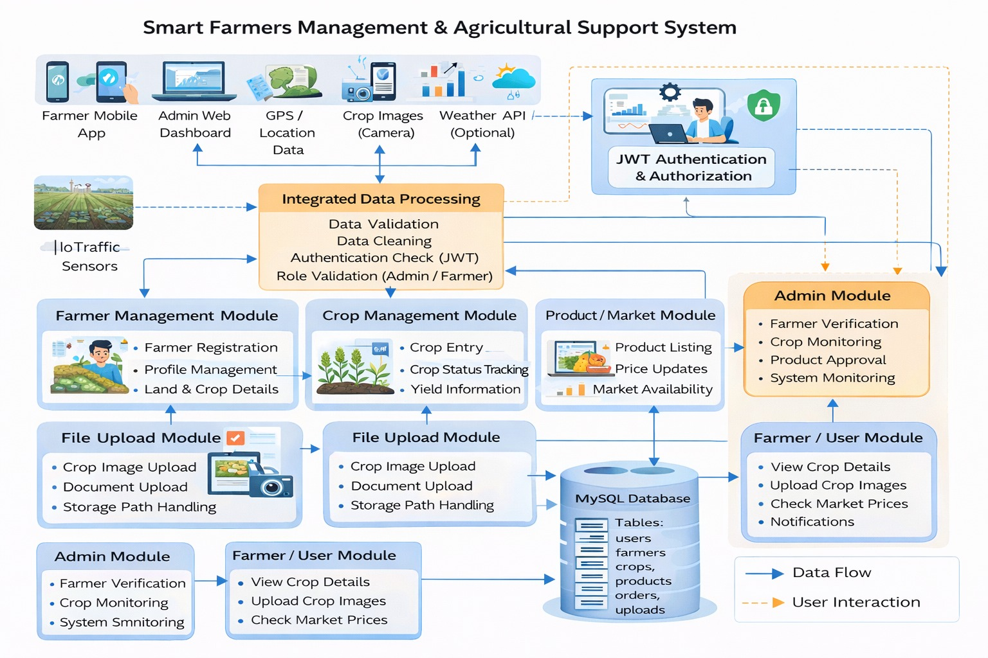
Architecture Diagram

Slide 12
MODULES
1) User Management Module
Sub-modules:
Farmer/Admin Registration
Login & Profile Management
2) Sensor & Data Collection Module
Sub-modules:
Automatic Sensor Data Collection
Manual Data Entry System
3) Data Transmission Module
Sub-modules:
Wireless Data Transfer (Wi-Fi/Internet)
Secure API Communication
4) Data Storage Module
Sub-modules:
Real-Time Data Storage
Historical Data Management
5) Data Processing Module
Sub-modules:
Data Cleaning & Validation
Data Normalization & Formatting
6) Analytics & Decision Support Module
Sub-modules:
Crop Recommendation System
Yield Prediction Analysis
7) Smart Irrigation Managements
Module
Sub-modules:
Water Requirement Calculation
Automated Irrigation cheduling
8) Alert & Notification Module
Sub-modules:
Weather & Climate Alerts
Crop & Irrigation Notifications
9) Monitoring & Visualization Module
Sub-modules:
Real-Time Dashboard Display
Graph & Report Generation
10) File & Report Management Module
Sub-modules:
File/Image Upload System
Report Export & Download
11) Security & Authentication Module
Sub-modules:
Token-Based Authentication
Data Encryption & Access Control
12) System Administration Module
Sub-modules:
User & System Configuration
Backup & Database Maintenance

Slide 13
Hardware and Software Requirements
Software Requirements:
IDE: Visual Studio Code
Runtime Environment: Node.js (v18.x or later)
Frontend: React.js, HTML, CSS
Backend & Database: NodeJS, MySQL
APIs: Weather, Soil, Satellite Imagery, AgriStack
Authentication: JWT (HttpOnly cookies), bcrypt
API Testing: Postman
Version Control: Github
Hardware Requirements:
No specialized hardware is required. A standard developer laptop with at least 8GB RAM and an internet connection is sufficient for development and deployment.

Slide 14
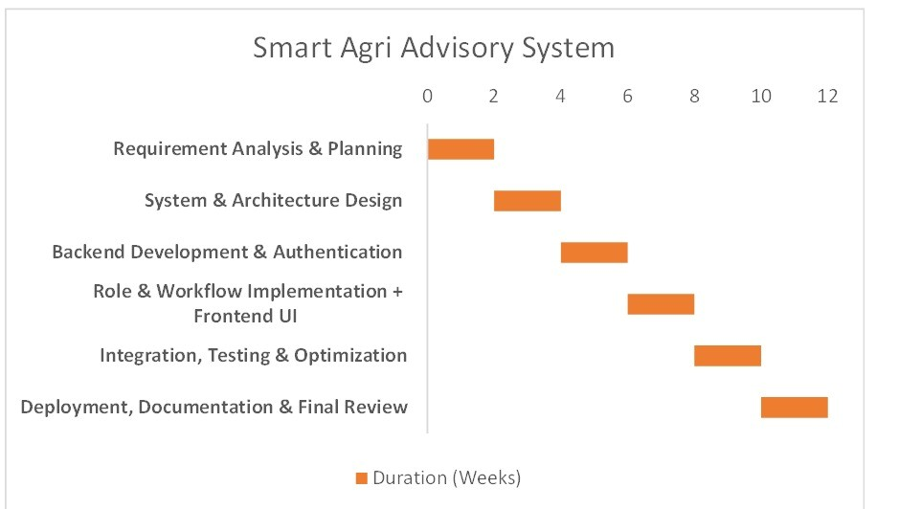
Timeline of the Project (Gantt Chart)

Slide 15
REFERENCES
[1] A. Sharma, R. Verma, and P. Singh, “IoT-based Smart Agriculture Monitoring System,” IEEE Access, vol. 10, pp. 45678–45689, 2022.
[2] S. Patel and R. Kumar, “Crop Suggestion Based on Soil Data,” in Proceedings of the International Conference on Communication Systems and Network Technologies (CSNT 2012), vol. 21, no. 14, pp. 15832 15841, July 2022.
[3] P. Ramesh, K. Rao, and S. Reddy, “Machine Learning Techniques for Precision Agriculture,” IEEE Transactions on Sustainable Computing, vol. 5, no. 3, pp. 234–245, 2020.
[4] K. R. Arvind and N. Ananthi, “Crop Yield Prediction Using Machine Learning Algorithms,” International Journal of Engineering and Advanced Technology (IJEAT), vol. 10, no. 6S, pp. 281–284, Aug. 2019.
[5] A. Sharma, A. Jain, P. Gupta, and V. Chowdary, “Machine Learning Applications for Precision Agriculture: A Comprehensive Review,” IEEE Access, vol. 9, pp. 4843–4873, Jan. 2021.
[6] R. S. Jayashree, T. Praveena, and K. S. Karthik, “Smart Irrigation System Based on Internet of Things and Artificial Intelligence,” Journal of Ambient Intelligence and Humanized Computing, vol. 12, pp. 1231 1242, Mar. 2021.

Slide 16
REFERENCES
[7] S. R. Patel and A. K. Shukla, “Soil Fertility Assessment and Crop Recommendation Using Data Mining Approach,” International Journal of Computer Applications, vol. 170, no. 7, pp. 5–10, July 2017.
[8] J. Li, J. Zhou, and H. Wang, “Real-Time Crop Monitoring System Based on IoT and Cloud Computing,” IEEE Internet of Things Journal, vol. 7, no. 9, pp. 8568–8577, Sept. 2020.
[9] M. Kamilaris, A. Kartakoullis, and F. X. Prenafeta-Boldú, “A Review on the Practice of Big Data Analysis in Agriculture,” IEEE Access, vol. 5, pp. 143–156, 2017.
[10] A. Khanna and S. Kaur, “Evolution of Internet of Things (IoT) and Its Significant Impact in the Field of Precision Agriculture,” IEEE Access, vol. 7, pp. 126305–126313, 2019.
[11] R. Ray, S. S. Dash, and A. De, “Internet of Things Based Smart Agriculture: Toward Making the Fields Talk,” in Proceedings of the IEEE International Conference on Intelligent Computing and Control Systems (ICICCS), pp. 541–546, 2018.
[12] S. Wolfert, L. Ge, C. Verdouw, and M. J. Bogaardt, “Big Data in Smart Farming: A Review,” IEEE Transactions on Industrial Informatics, vol. 13, no. 6, pp. 3097–3108, Dec. 2017

Slide 17


